Slide 1
ALGOVISUALISER
Visualise and Learn

Slide 2
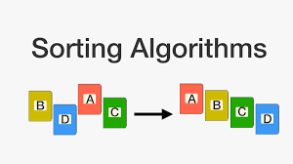

INTRODUCTION
It is often said that the what you see is what you learn the best .
Keeping this is mind we aim to help students learn sorting and
searching techniques and their working by visualising them.

Slide 3
PROBLEM STATEMENT
Some students have difficulty in translating the algorithms into dynamic behaviour of data structures in executable programs . The text of an algorithm is generally short and some students find it difficult to comprehend . Some students are comfortable with one data structure but not comfortable with another .
Many students learn the text of an algorithm without knowing its actual working and implementation . In doing so they might score well in college offline exams but fail when asked for a practical .

Slide 4
DESIGN AND IMPLEMENTATION
This project is a pure development project and is made using html , css , javascript , sorting and searching algorithm etc . To see the visualization of any algorithm user must decide b/w sorting and searching techniques . According to his/her choice the user will be directed to select a random array or enter his own array . If use choosed searching then he/she will be requested to choose a number to be searched else it will direct them to choosing algorithm where after choosing the algorithm they will see visualization and then the final result.

Slide 5
FLOW CHART
START
ACTION
SORTING
SEARCHING
RANDOM
ARRAY
USER ARRAY
USER ARRAY
USER ARRAY
CHOOSE NUMBER
CHOOSE ALGORITHM
CHOOSE ALGORITHM
BUBBLE
INSERTION
SELECTION
Quick
MERGE
LINEAR
BINARY
JUMP
EXP
VISUALISATION
RESULT
VISUALISATION
RESULT

Slide 6
FEATURES :
Visualisation of sorting algorithms
Visualisation of searching algorithms
Time complexity , pseudo code and complete code of algorithms.
TECHNOLOGY USED :
HTML
CSS
JAVASCRIPT
SVG
REACT JS and D3

Slide 7
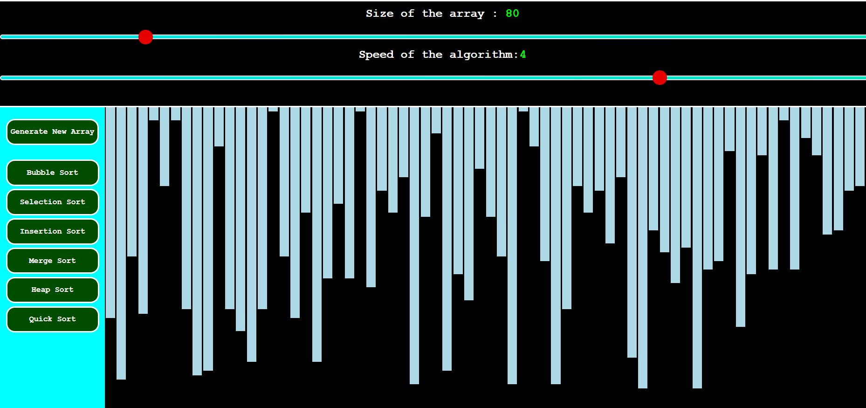
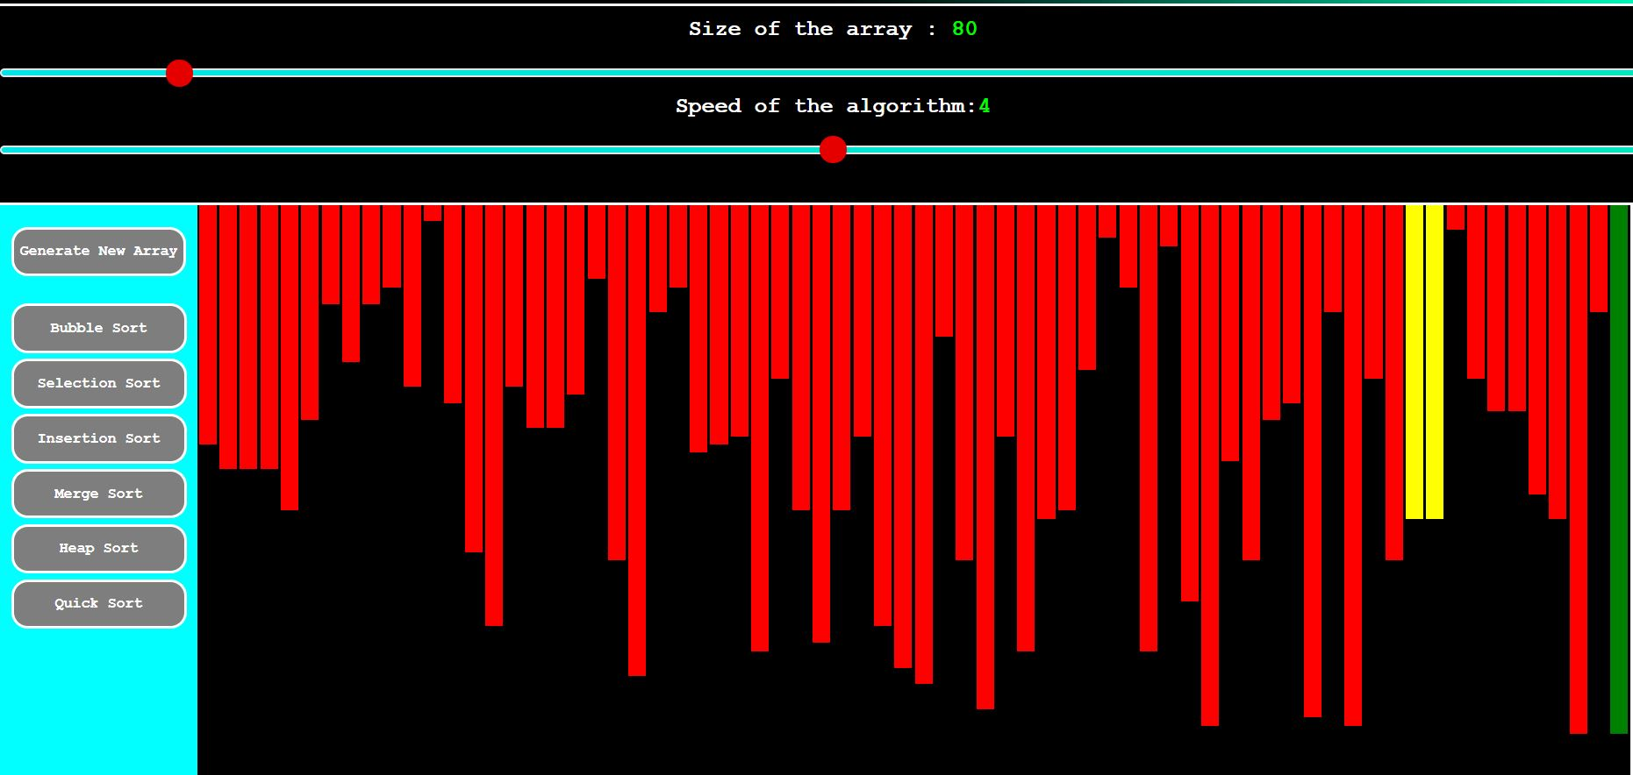
SCREENSHOTS

Slide 8
REPORT
To view report , click here -
https://docs.google.com/document/d/14nNqqWTZnDqDAz3cRDWPDGf5bdKSZ45Z38Ccwi944UA/edit?usp=sharing

Slide 9
PROJECT MEMBERS
SARISHTY GUPTA
Project Superviser
Sahil Rastogi
Shubham Gupta
Prashant Kartikay
18104059
B12
18103264
B8
18103315
B8

